Slide 1




The effect of previous COVID-19 infection on blood pressure control
Liam Berkland
Dr. Sara Jarvis
Northern Arizona University
Notes:
Hi everyone, my name is Liam Berkland. My advisor’s name is Dr. Jarvis.
This is my PowerPoint presentation on the research I’ve conducted so far for the NASA space internship program here at NAU.
The title of my project is _____

Slide 2

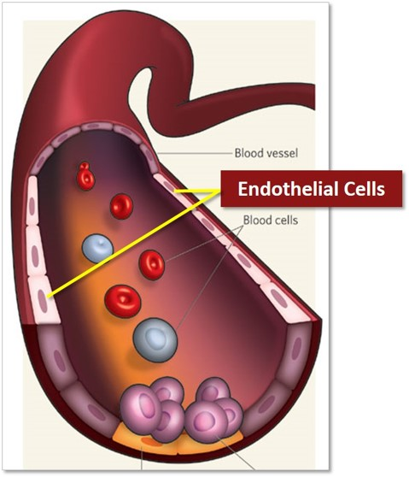
Background
Astronauts can experience post-spaceflight orthostatic intolerance when returning from space
Orthostatic intolerance:
  The inability to regulate blood pressure when placed in an upright position
  Symptoms can include lightheadedness, loss of peripheral vision, sudden drops in blood pressure, syncope
  Safety risk
COVID-19 enters the body’s cells through ACE-2 receptors
  These receptors are present in endothelial cells
  Endothelial cells: play a role in blood pressure regulation
  Binding of virus can cause damage
  Greater blood pressure dysregulation can further compromise an astronaut’s safety
Notes:
Background: Astronauts often experience a serious health problem called post-spaceflight orthostatic intolerance when returning from space.
Orthostatic intolerance is the inability to regulate blood pressure when placed in an upright position.
Symptoms can include lightheadedness, loss of peripheral vision, sudden drops in blood pressure, or even pass out.
This poses a safety risk to astronauts as it can impact their ability to rapidly egress from a spacecraft in an emergency landing.
With this being a problem before COVID-19 emerged, it is important to understand how an astronaut that was infected with COVID-19 might be impacted when returning from space.
COVID-19 enters the body through enzymes present in the lungs, heart, intestines, kidneys, pancreas, brain, and in cells that make up our blood vessels.
These cells that make up our blood vessels are partly responsible for regulating and maintaining blood pressure.
When the virus binds to these enzymes, it can cause damage and result in difficulty maintaining blood pressure.
Greater blood pressure dysregulation could potentially cause worsening in symptoms of orthostatic intolerance and further compromise an astronaut’s safety when returning from spaceflight.

Slide 3
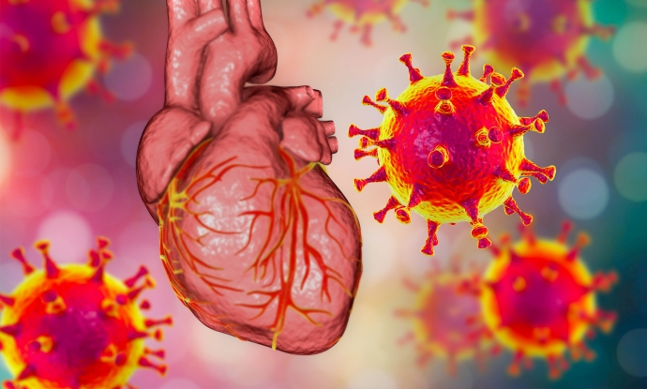

INTRODUCTION
Purpose:
  To determine the effects of a previous COVID-19 infection on blood pressure regulation.
Hypothesis:
  Individuals previously infected with COVID-19:
    Hyper-reactivity during cold pressor test
    Lower tilt-table tolerance
Notes:
The purpose of this study is to determine the effects of a previous COVID-19 infection on blood pressure regulation in otherwise healthy women and men and relate this to how a prior COVID-19 infection could potentially affect the safety of astronauts when returning from space.
Hypothesis: We hypothesize those previously infected with COVID-19 will have a degree of blood pressure dysregulation when exposed to a cold pressor test and a tilt tolerance test when compared to those not previously infected with the COVID19 virus.

Slide 4
Subject characteristics
Subject Characteristics
 | CONTROL Group (n=7) | COVID-19 Group (n=6)
Age (years) | 19±2 | 20±1
Height (meters) | 1.7±0.1 | 1.7±0.1
Weight (kg) | 68±12 | 55±9
BMI (kg/m²) | 23±3.4† | 19.5±2.3
Resting SBP (mmHg) | 106±12 | 110±4
Resting DBP (mmHg) | 69±7 | 75±5
Resting HR (beats/min) | 77±13 | 86±2
Values are mean±SD
† Significant difference between groups (p<0.05)
Notes:
We are still in the process of recruiting participants and collecting data, so for this presentation we analyzed 13 subjects.
13 healthy men and women (Table 1-Characteristics) over 18 years of age gave their written informed consent before participating in the present study, which was approved by the NAU IRB committee.
When comparing baseline measurements, there was a significant difference in BMI between the C19 and control groups in terms of BMI (C19 group was smaller).

Slide 5
METHODS
Cold pressor test
5-minute baseline
Tilt test
5-min baseline
2 minutes in ice water (2℃–4℃)
3-minute recovery period
70° head-up tilt for up to 45 minutes or until presyncope
5-min recovery
10-minute rest period
Notes:
The study consisted of two visits, a consent visit and study visit, that participants reported to the lab for.
The consent visit involved lab personal going over the study in great detail with the participant and answering any questions they had.
Once consent to participate in the study was given, height, weight, resting heart rate, and resting blood pressure were taken.
The study visit was performed after the consent visit and consisted of a cold pressor test followed by a tilt-table test.
The cold pressor test consisted of a 5 min baseline. This was followed by placing the subject’s hand into a container with 50% water and 50% ice for 2 minutes. Lastly, this was followed by a 3-minute recovery period.
Before the participants continued onto the tilt-table test, there was at least a 10-minute rest period to allow their blood pressure and heart rate return to normal values.
Subjects were instructed to relax and keep their knees locked. The test was immediately terminated if the subjects complained of any abnormal symptoms (dizziness, light-headedness, nausea, difficulty breathing, etc.).
We monitored heart rate, blood pressure, breathing rate, and assessed tilt time during the tilt table test.
After a 5-min baseline, the subject was passively tilted on the tilt table to a 70-degrees head-up tilt for 45 minutes or until presyncope (or until blood pressure becomes too low). This was then followed by 5 minutes of recovery in a supine position.
After a short recovery from the tilt, the subjects were disconnected from all the monitoring devices.

Slide 6
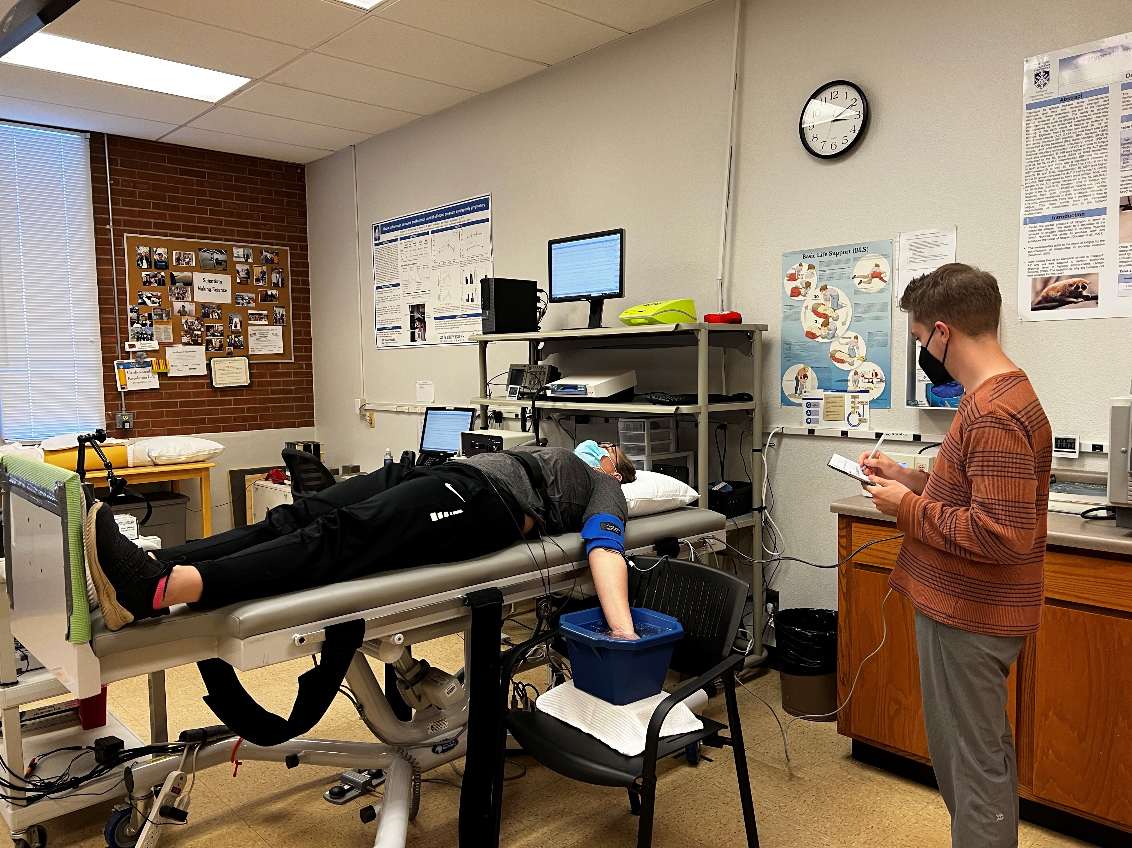
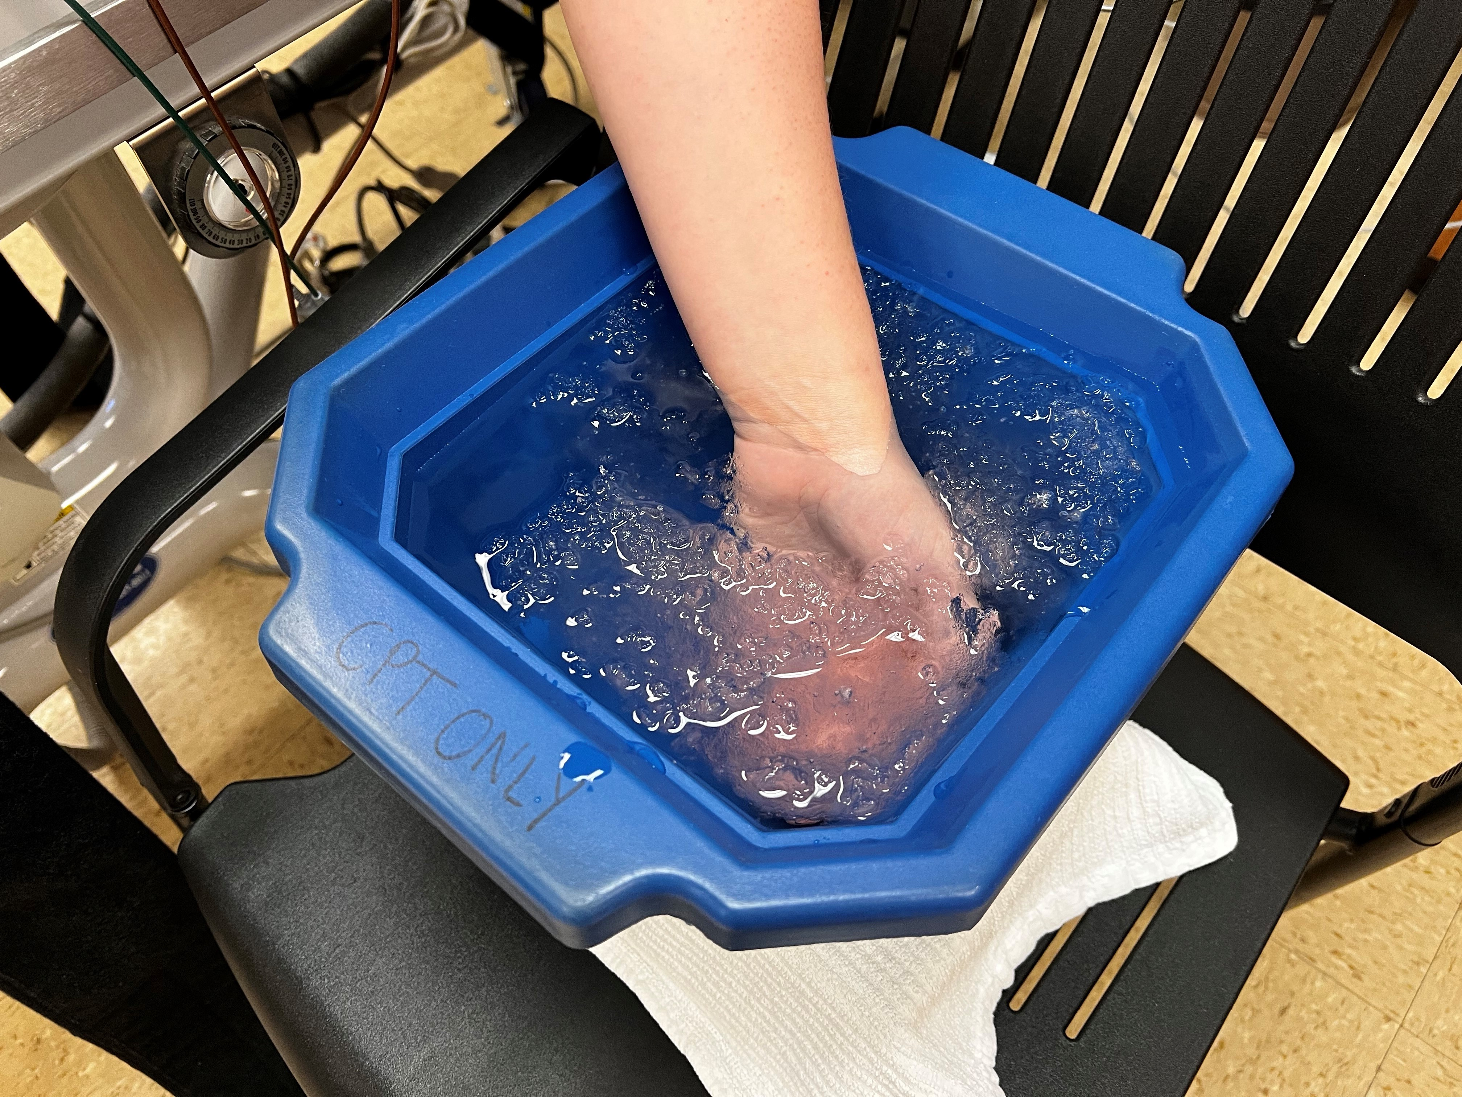
Cold pressor test

Slide 7
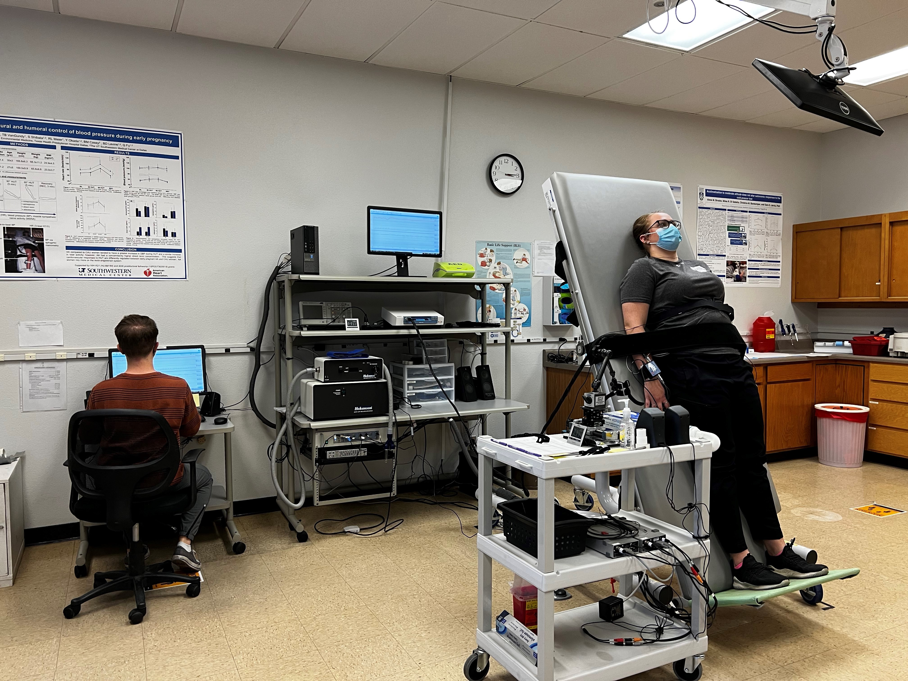
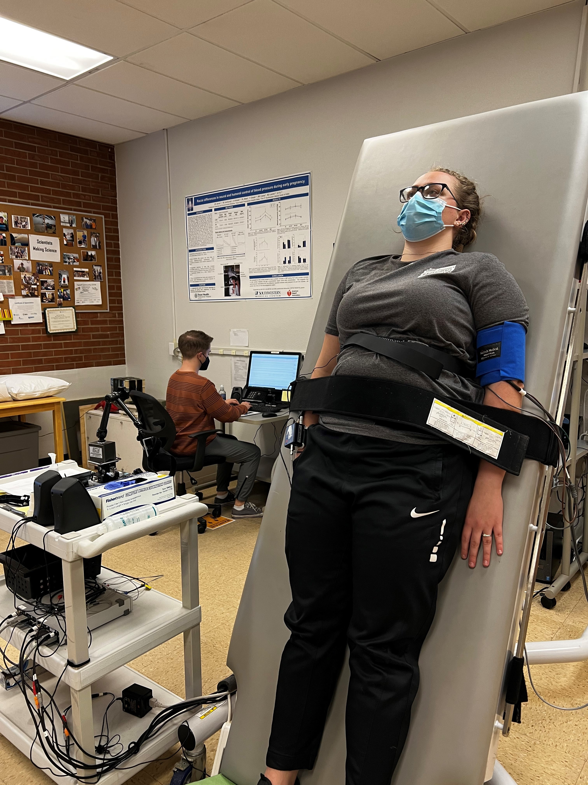
Tilt-Table test

Slide 8
CPT results
Notes:
For CPT, there were no significant changes in heartrate (HR) between baseline (BL) and cold-pressor testing (CPT2) in both groups or between groups.

Slide 9
CPT results
*
* Significant difference between phases
Notes:
SBP and DBP increased from BL to CPT in both groups but were not different between groups.

Slide 10
TILT results
* Significant difference between phases
Notes:
For TILT, heartrate was significantly higher during tilt testing (HUT) than BL for both groups but was not different between groups.

Slide 11
TILT results
Notes:
SBP and DBP had no significant changes between phases of testing or between groups.

Slide 12
Tilt results
Notes:
No difference between the two groups.

Slide 13
Tilt Results
 | CONTROL Group (n=7) |  |  | COVID-19 Group (n=6)
 | TILT BL | TILT | TILT REC | TILT BL | TILT | TILT REC
TPR (mmHg x s/mL) | 0.82±0.16 | 1.1±0.28* | 0.81±0.16 | 0.7±0.14 | 1.03±0.23* | 0.76±0.16
Stroke Volume (ml/beat) | 73±9* | 41±5 | 80±11 | 84±10* | 40±4 | 88±10
Cardiac Output (L/min) | 4±1* | 4±1 | 4±0 | 4±0†* | 3±1 | 4±0
Cardiac Index (L/min/m²⁾ | 1.3±0.29 | 1.3±0.25 | 1.3±0.25 | 1.55±0.23† | 1.2±0.21 | 1.27±0.2
Values are mean±SD
* Significant difference between phases (p<0.05)
† Significant difference between groups(p<0.05)
Notes:
TPR was significantly higher during tilt than during BL in both groups.
Cardiac output was significantly higher at BL in the COVID-19 group and was lower during TILT than during BL for both groups.
Cardiac index was significantly higher at BL in the COVID-19 group.
Stroke volume was significantly lower during TILT than during BL for both groups, but there was no difference between groups.

Slide 14
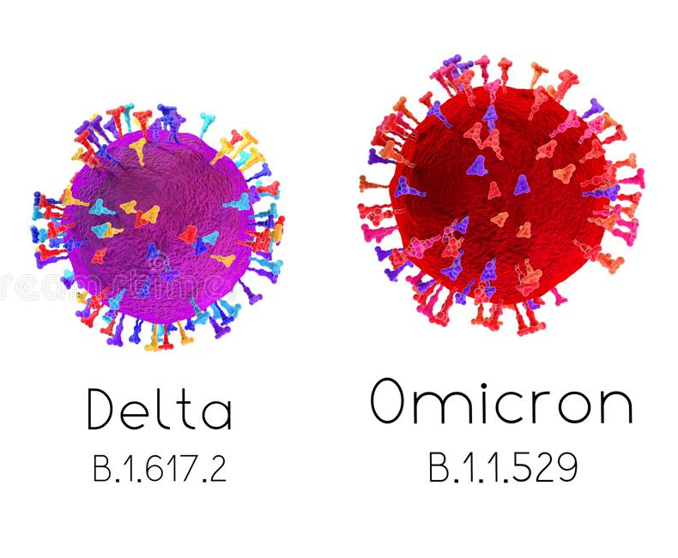

CONCLUSION
From current data collected:
  No significant difference between groups in HR and BP for both CPT and HUT
  No significant difference between groups in average tilt times
  COVID-19 group had a significantly higher cardiac index at BL compared to control
Things to consider:
  Data analyzed from 13 subjects
  Variants
Notes:
From the current data collected, no significant difference was found between groups regarding change in heart rate and blood pressure for both the cold pressor test and tilt table test, and there was no significant difference in average tilt times between groups.
However, we did find a significant difference in cardiac index with the COVID-19 group having a significantly higher cardiac index at BL compared to the control group.
Cardiac index measures the volume of blood pumped from the left ventricle per minute, with body surface area accounted for. The higher cardiac index was not maintained during the tilt portion and so there was no benefit gained from the higher cardiac index.
More serious variants of SARS-CoV-2 existed when this study was proposed.
For this study, we are aiming to recruit 32 subjects with 8 in each group (male control, female control, male C19, female C19). As of now however, we have only collected data on 13 subjects (3 male controls, 4 female controls, 2 male C19, and 4 female C19), so these results are not conclusive. We will continue to collect data on the remaining subjects.

Slide 15
ACKNOWLEDGMENTS
Subjects who participated
Dr. Jarvis
Personnel of NAU’s Cardiovascular Regulation Lab
NAU/NASA Space Grant Internship
Arizona Space Grant Consortium

Slide 16

Thank you!
Any questions?

